Slide 1
TGFb in activated hepatic stellate cells as the modulator of
collagen accumulation in chronic liver disease
Viktor Makarenko, AG Klingmüller, Heidelberg
Daniel Lill, AG Timmer, Freiburg

Slide 2
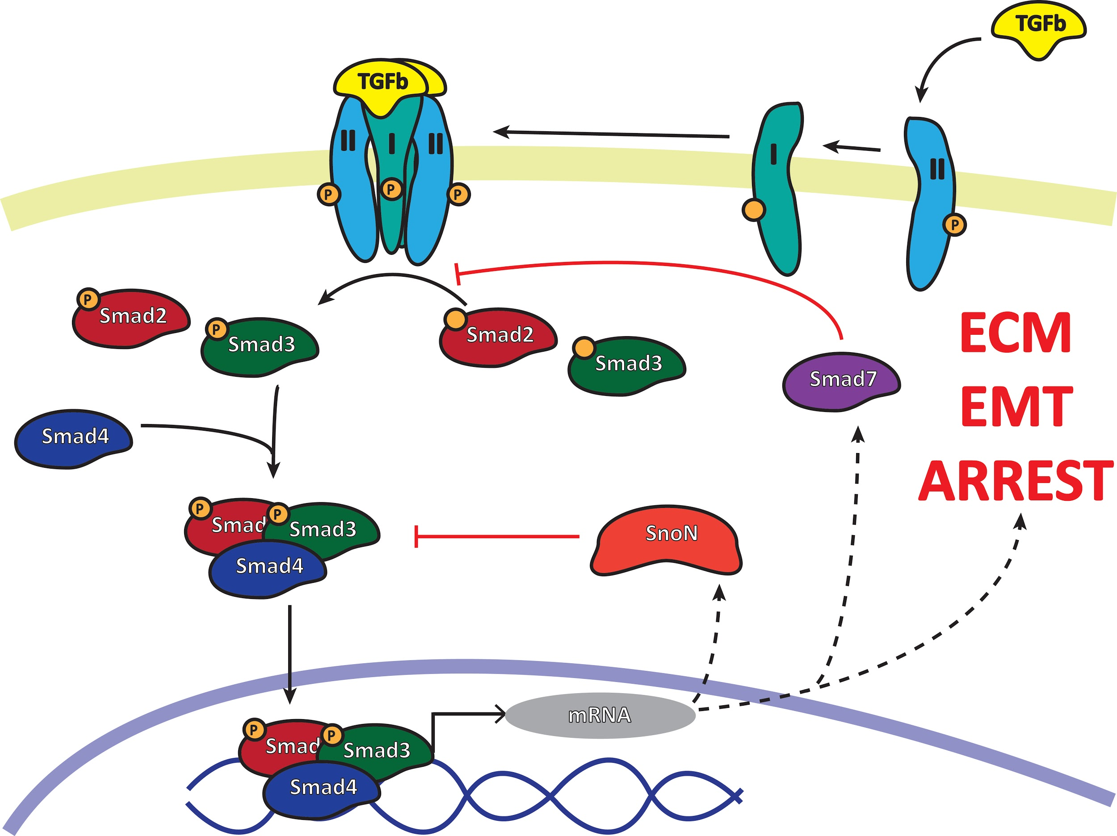
TGFb as the main driver of liver fibrosis
Relatively simple relay transduction
Multiple regulatory feedback loops
Cell context-dependent response

Slide 3
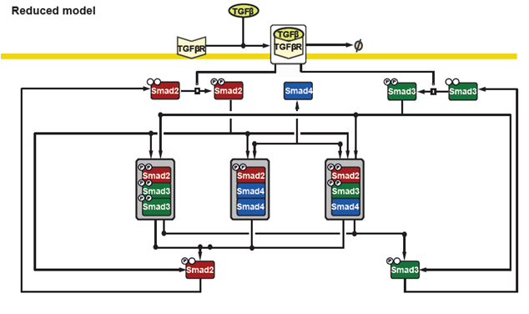
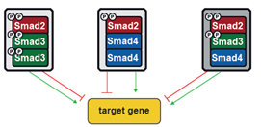
Previously established model
Hepa1-6
Established in primary hepatocytes and hepatoma cell lines
Demonstrated relevance of Smad trimers for Gene regulation
HepG2
PMH
PHH
Lucarelli et al. (Cell Systems 2018)

Slide 4
Model adaption to Hepatic stellate cells
JS1
Clinical relevance in CLD
Detection of potential markers
Intervention strategies
LX2
ECM Genes
ECM Proteins
Lucarelli et al. (Cell Systems 2018)
Notes:
Brief introduction to stellate cells in CLD

Slide 5
Model adaption

Slide 6
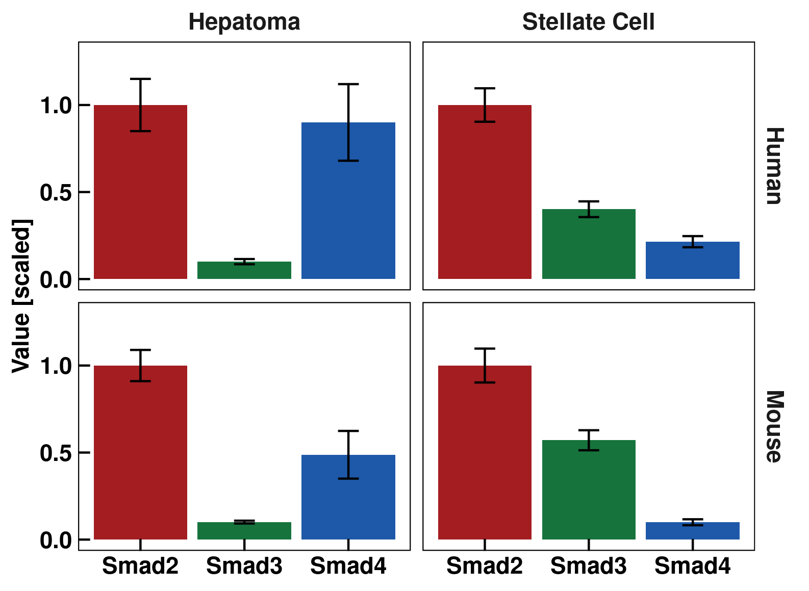
Abundances of Smad proteins
Smad ratios are similar in similar cell types
Model adaption
Adjust total values of Smad complexes
Lucarelli et al. (Cell Systems 2018)

Slide 7
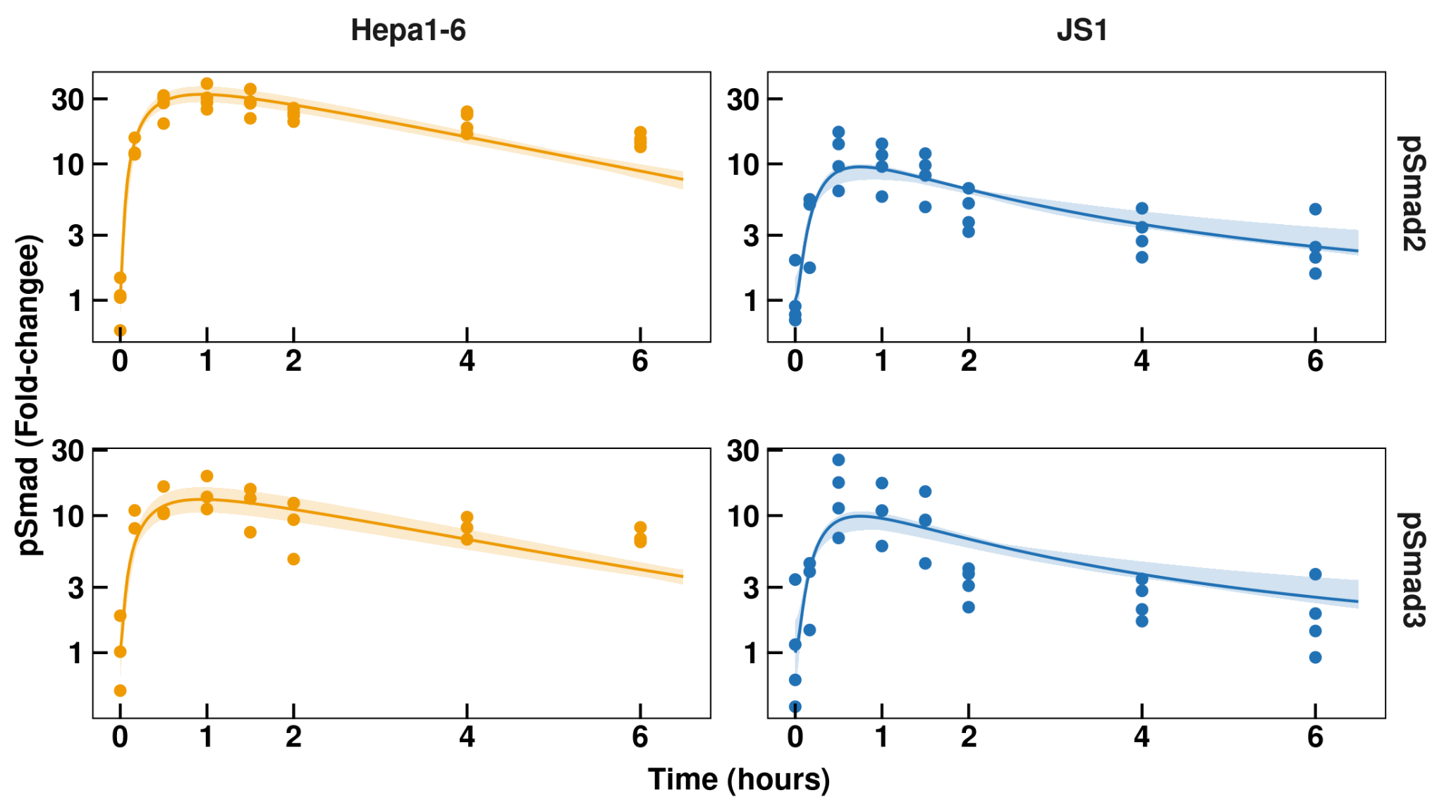
Similar Smad activation dynamics
Similar phosphorylation dynamics of HSC and hepatocytes
Different levels of Smad activation due to difference in Smad concentrations
Model adaption
Keep kinetic parameters of phosphorylation/dephosphorylation

Slide 8
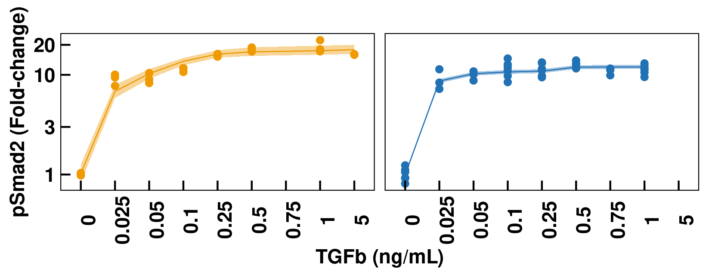
JS1 is fully activated at low TGFß concentrations
HSC pSmad2 response saturates at lower doses of TGFb
Model adaption
Incorporate basal phosphorylation

Slide 9
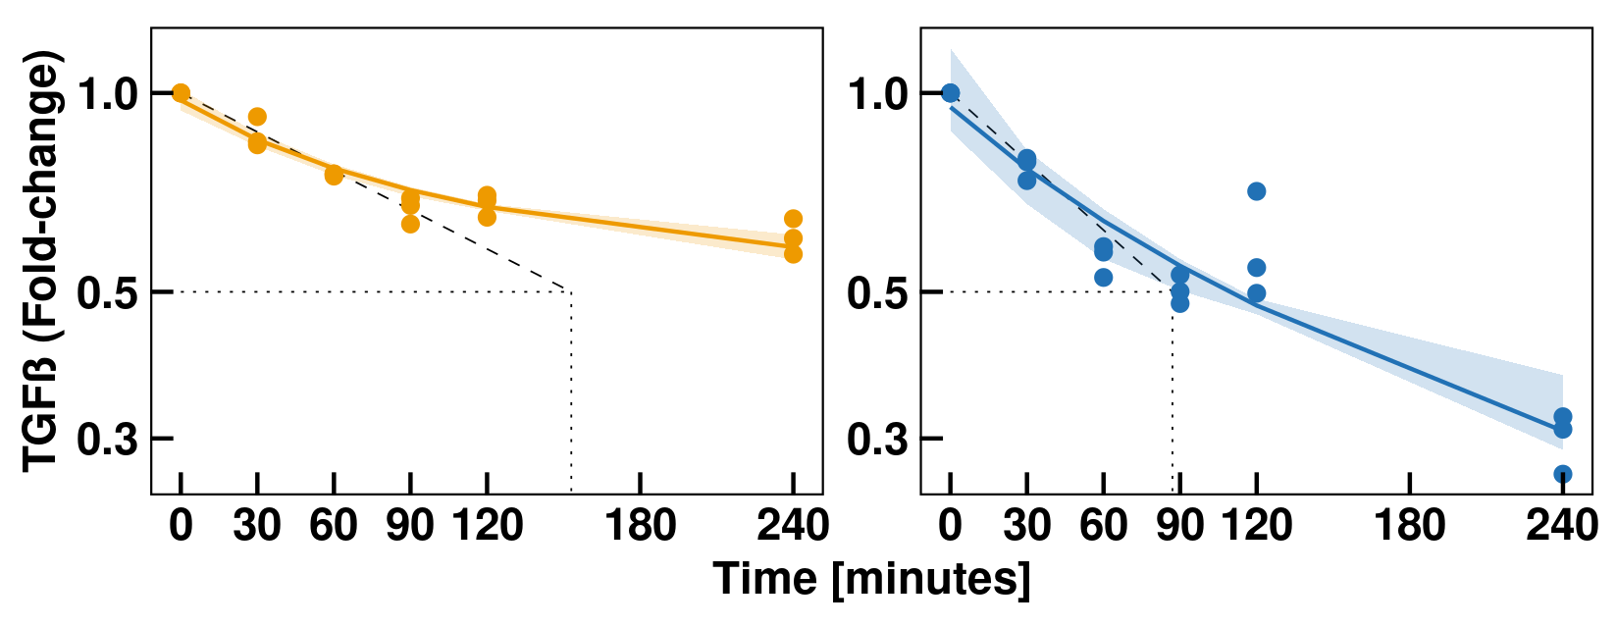
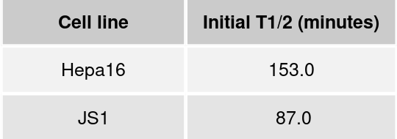
JS1 depletes TGFß faster than Hepa1-6
HSC deplete TGFb faster than hepatocytes
Model adaption
Incorporate receptor turnover model

Slide 10
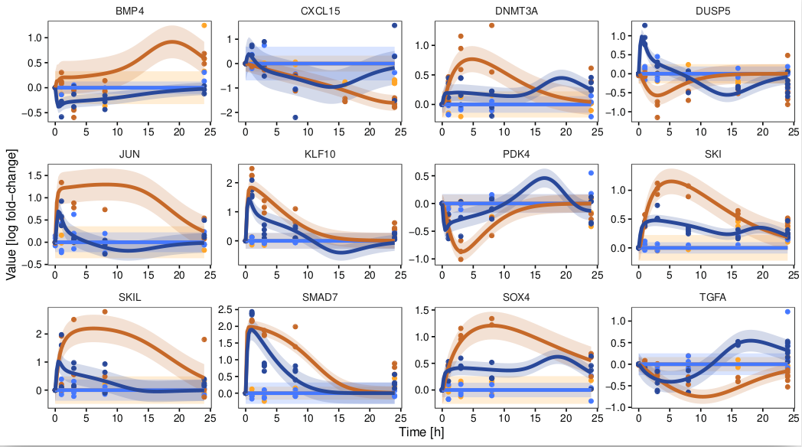
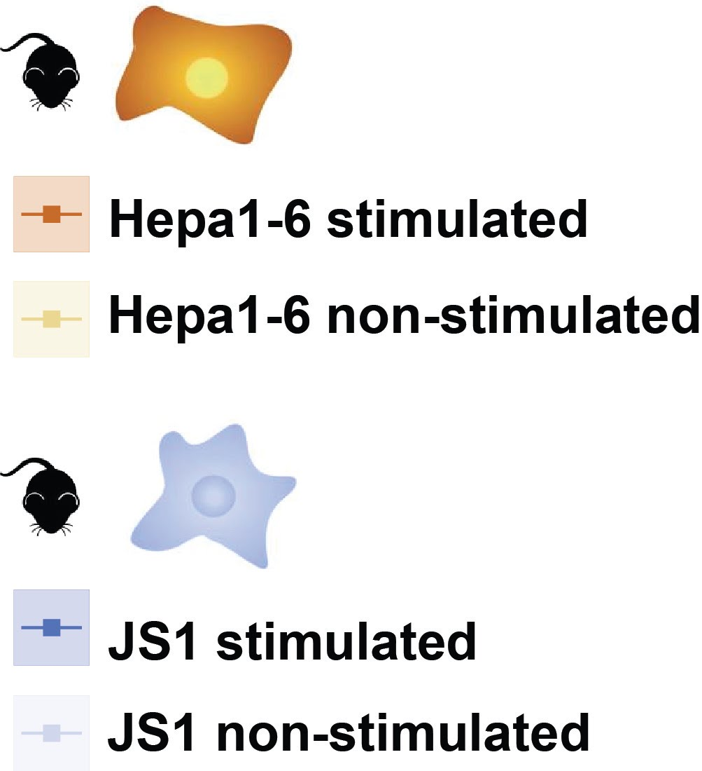
The adapted model describes gene regulation in HSC
Model can explain JS1 data
on the basis of Smad molecules abundance
Model adaption
Keep most kinetic parameters of gene regulation
Refit only few parameters
Notes:
some gene parameters had to be refitted though …

Slide 11
The adapted model describes gene regulation in HSC
Model can explain JS1 data
on the basis of Smad molecules abundance
No ECM-related genes in clusters representatives
Extension of model by new ECM-related targets
Notes:
some gene parameters had to be refitted though …
Conclude:
Model can be used for JS1
Changes of smad abundances impact gene transcription
Some gene parameters had to be refitted though …
Up to here: No ECM & Fibrosis related genes => NEED TO FIND NEW TARGET => Mass-spec
Mass-spec because protein accumulation more relevant than transcription
Formulate positively :)

Slide 12
Model extension

Slide 13
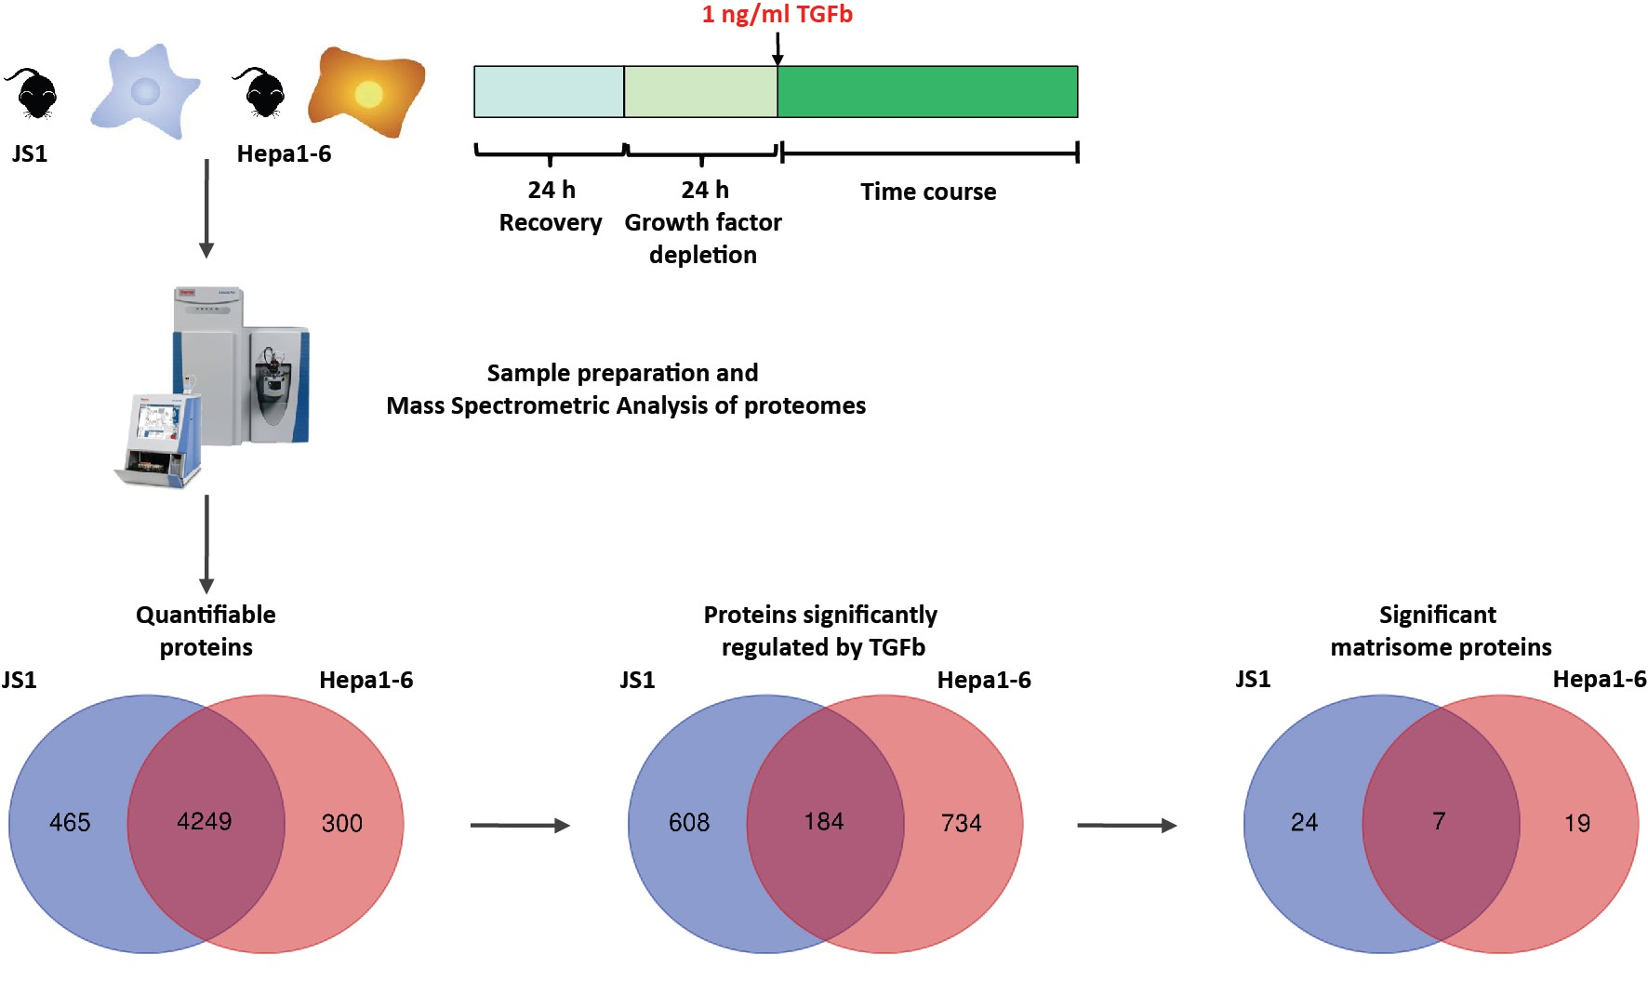
Global mass spectrometry to elucidate HSC-specific targets

Slide 14
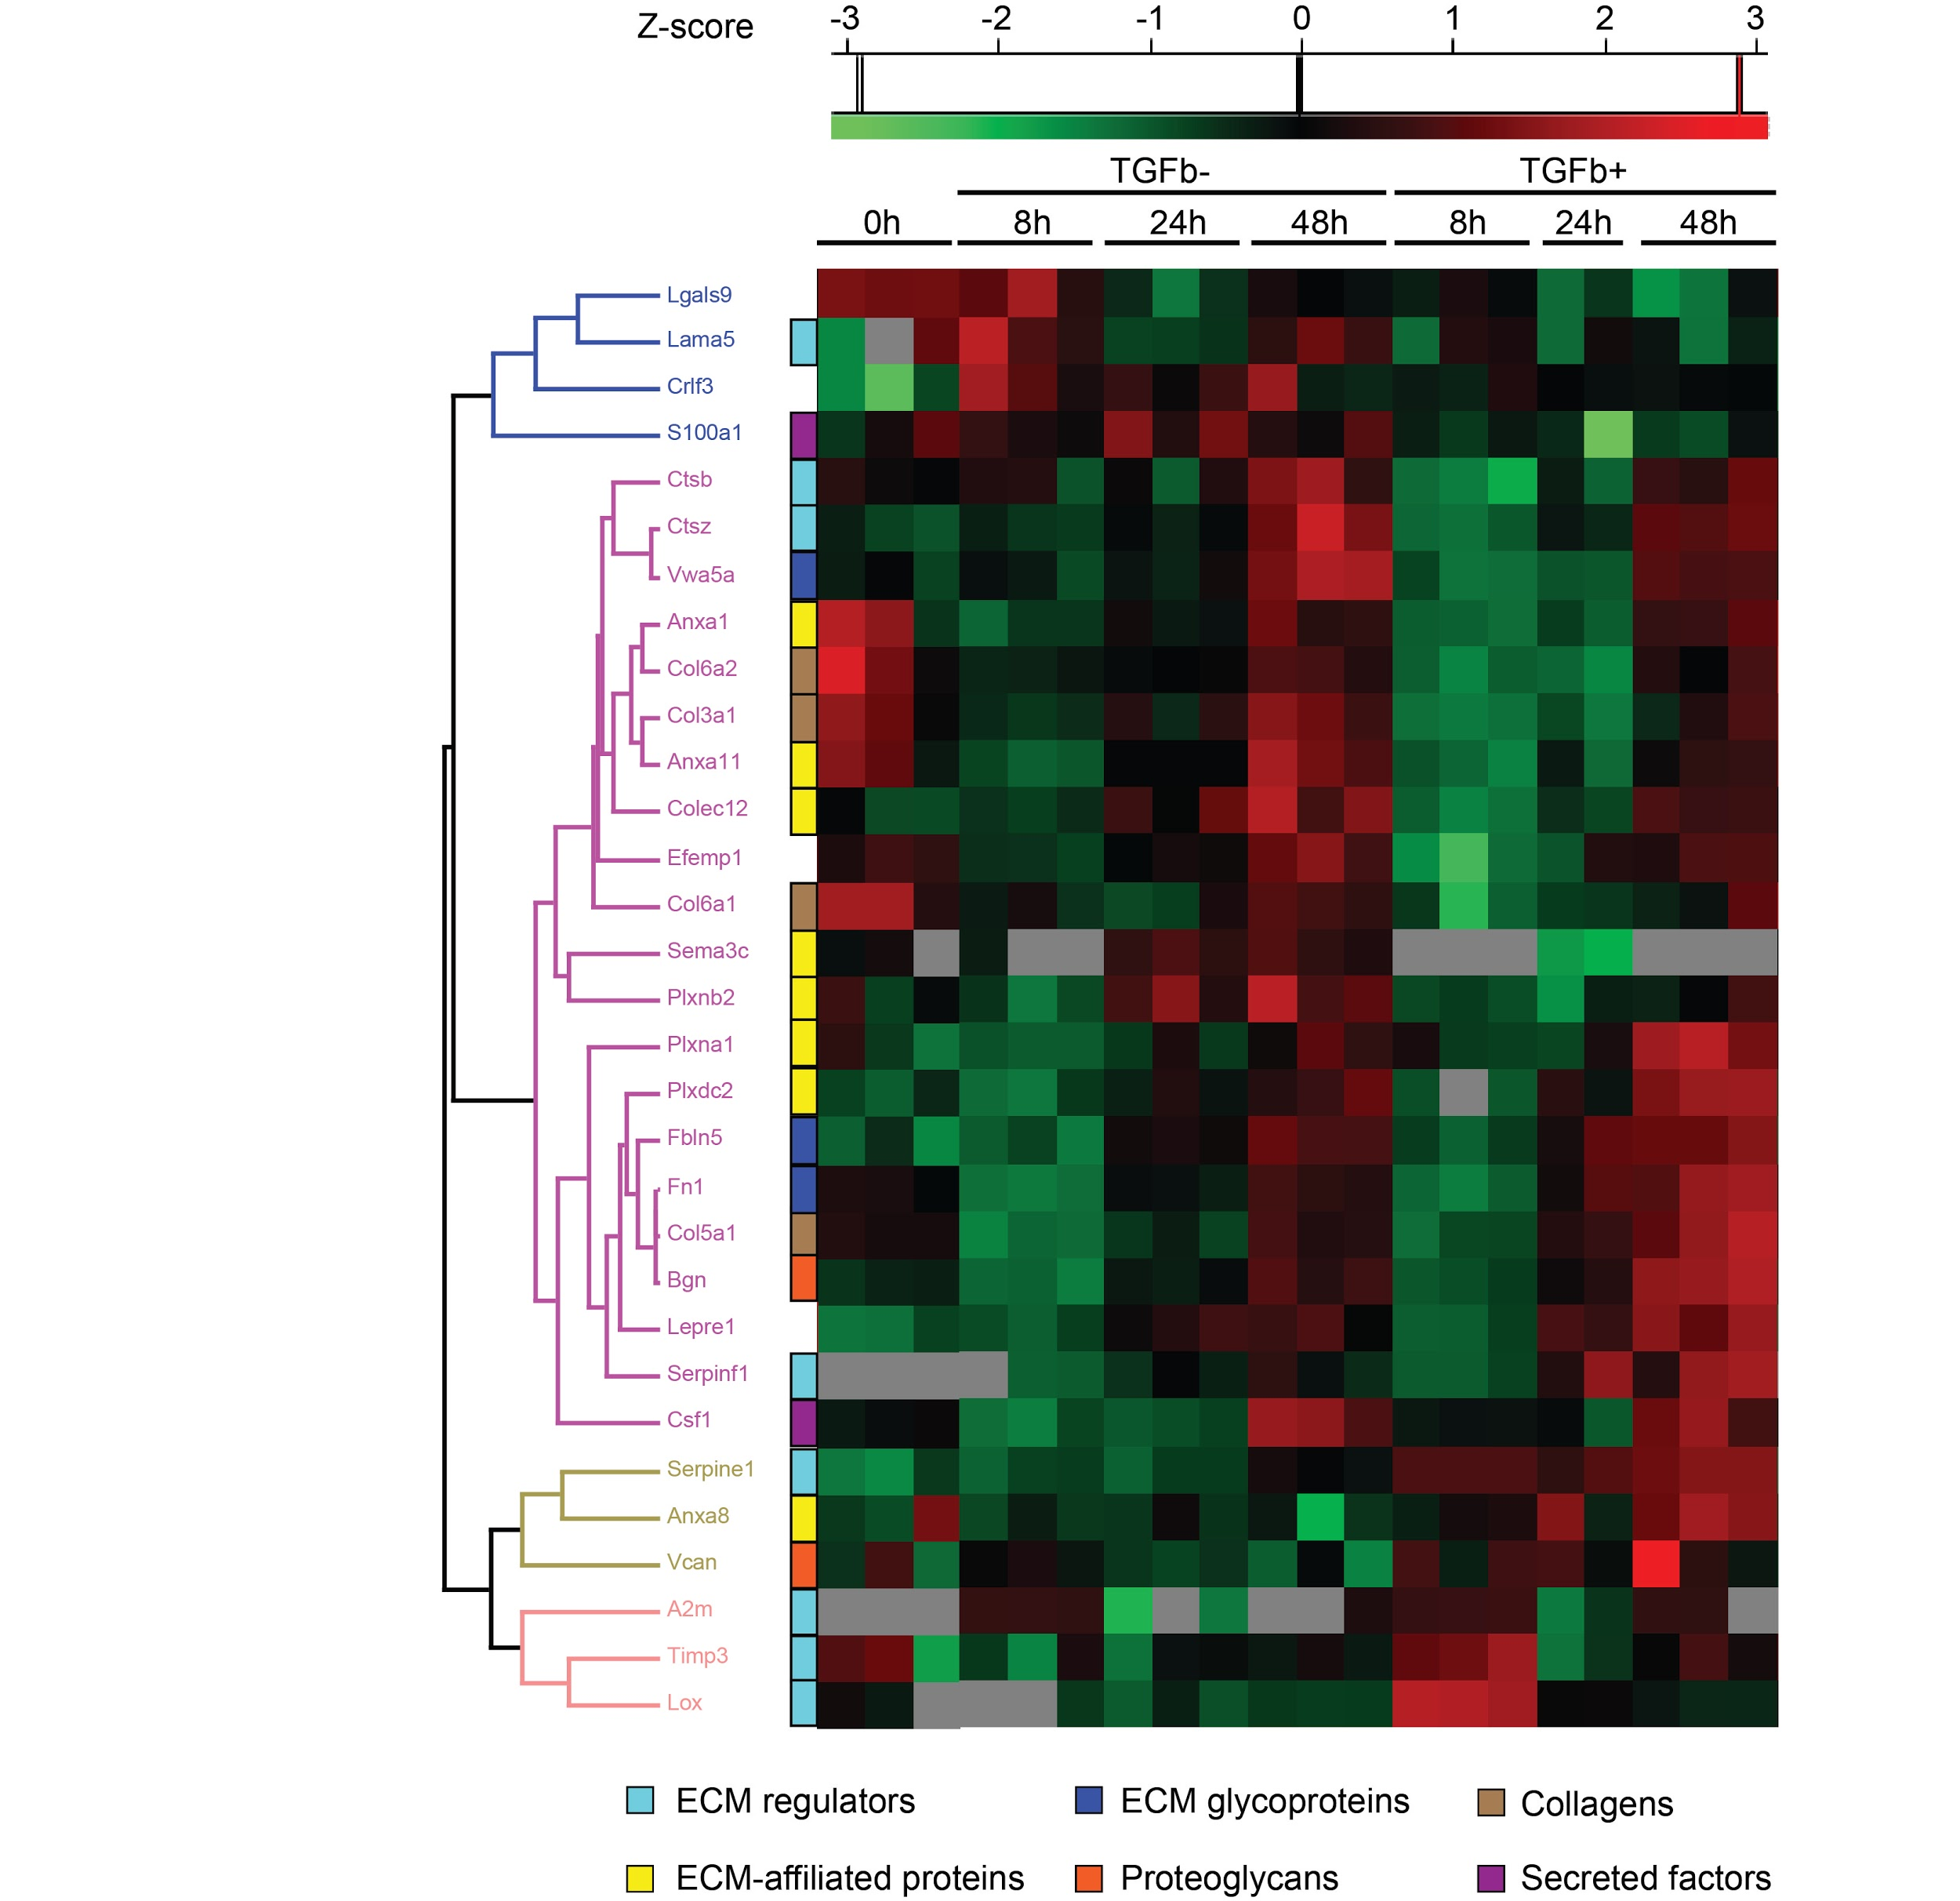
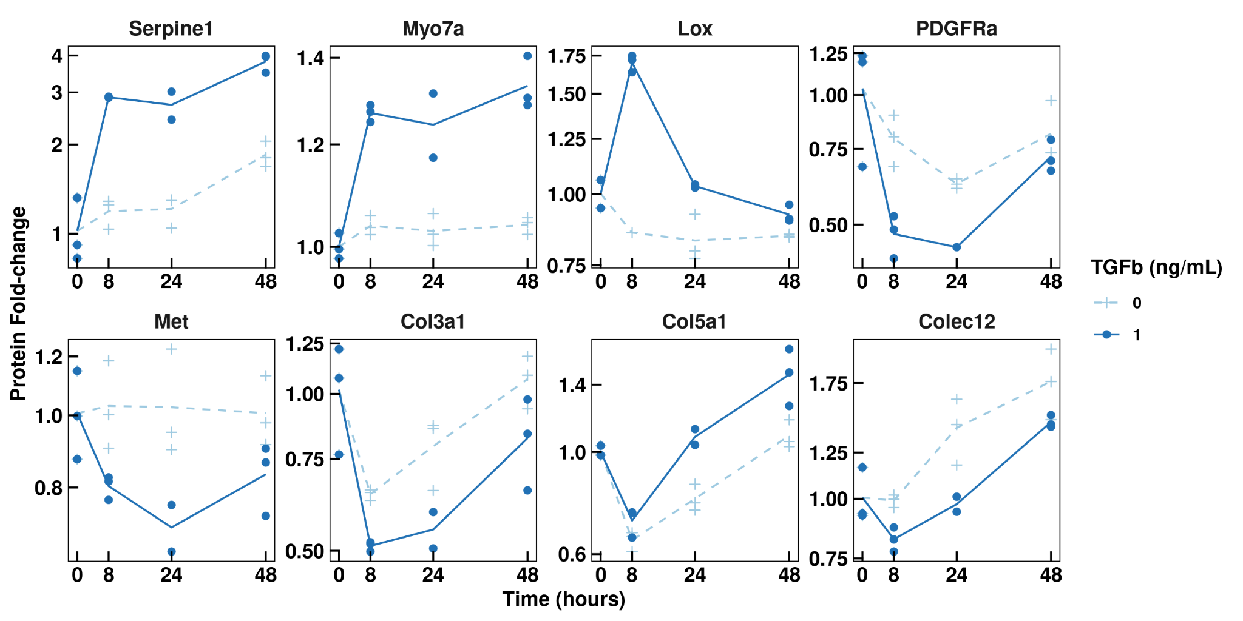
Global mass spectrometry to elucidate HSC-specific targets
Direct targets of TGFb are associated to ECM remodelling
are identified (Serpine1, Lox)
Collagens are also affected by TGFb but on the late time
points
Notes:
Direct targets of TGFb are associated to ECM remod. Are identified: (Serpine1, Lox)
Colagens are also affected by TGFb but on the later time points

Slide 15
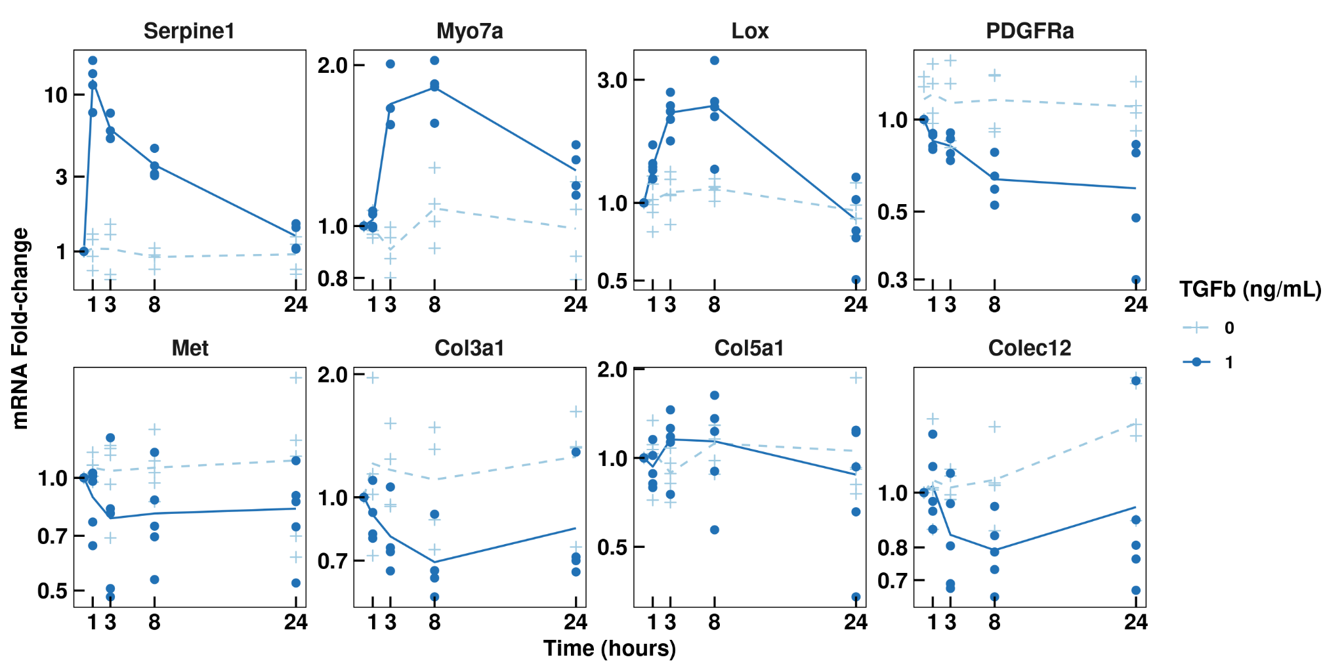
Gene expression dynamics of potential candidates
Collagens are not significantly affected by TGFb on mRNA levels
Collagens are regulated post-transcriptionally?
Notes:
Collagens are remodeled by early-response proteins

Slide 16
Gene expression dynamics of potential candidates
Selected candidates:
Serpine1 - well known direct target of TGFb signalling,
shared in Hepa1-6 and JS1
Myo7a - marker of EMT transition,
shared in Hepa1-6 and JS1
Lox - HSC-specific marker in liver
Notes:
Collagens are remodeled by early-response proteins

Slide 17
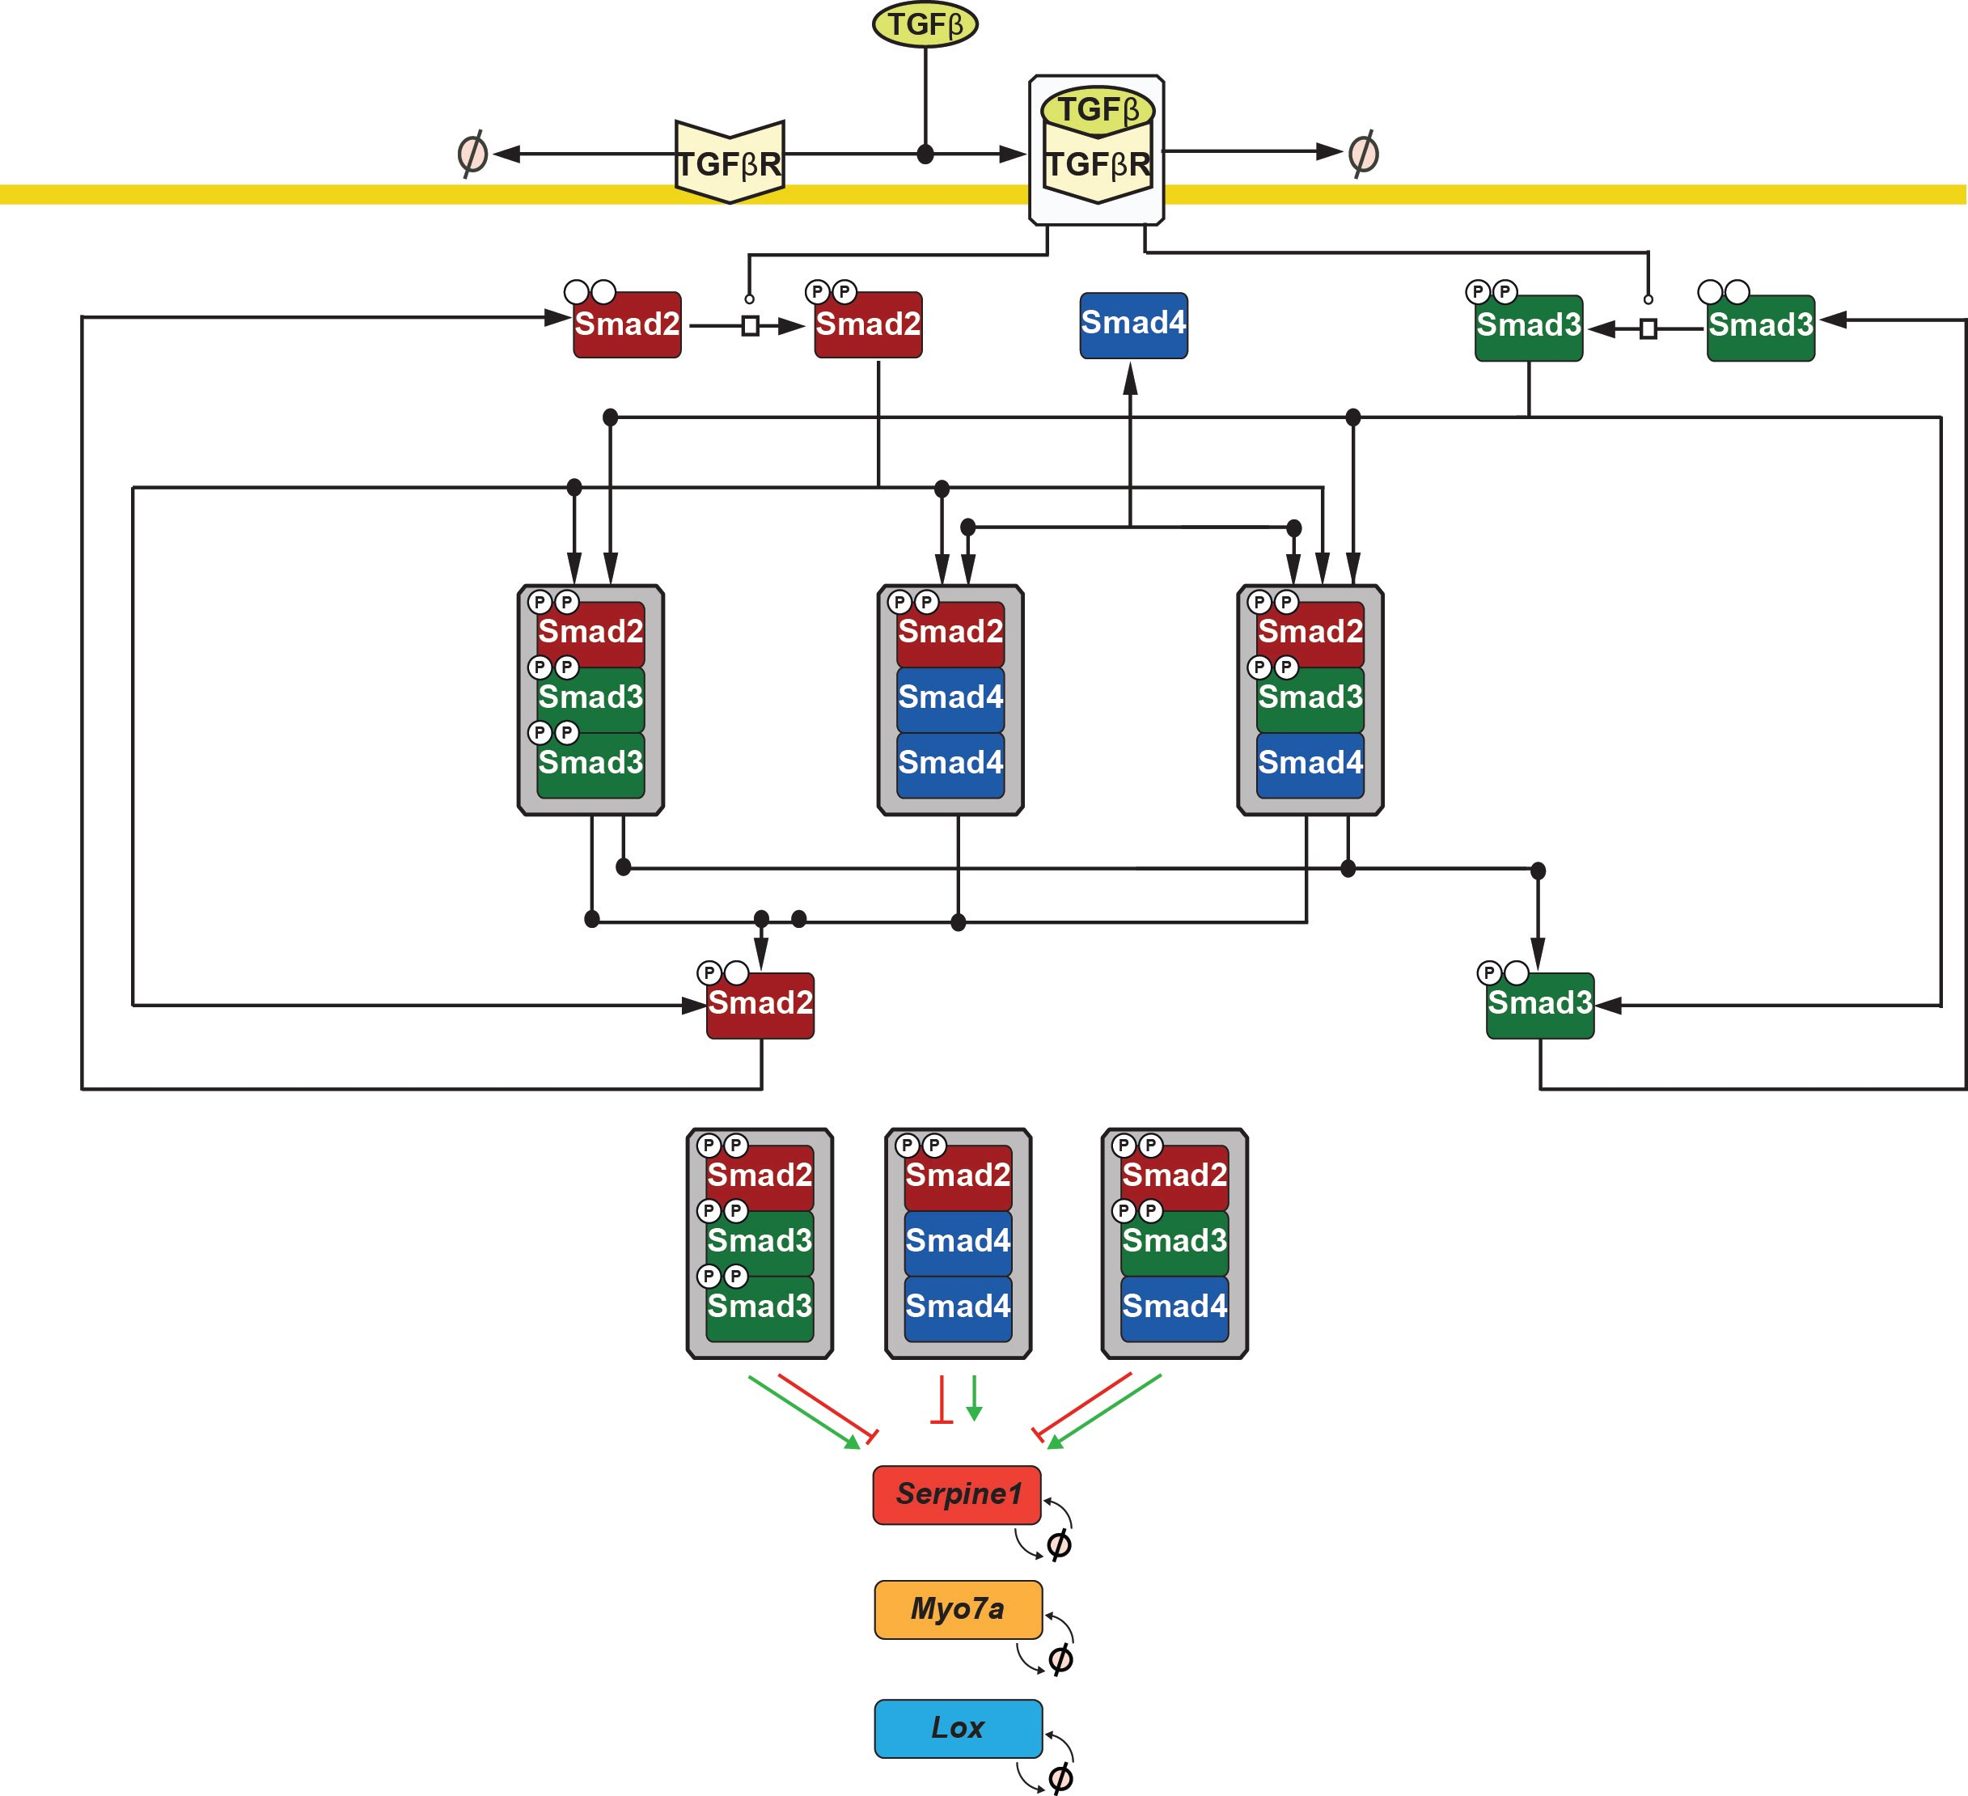
Extension of model by new target genes

Slide 18
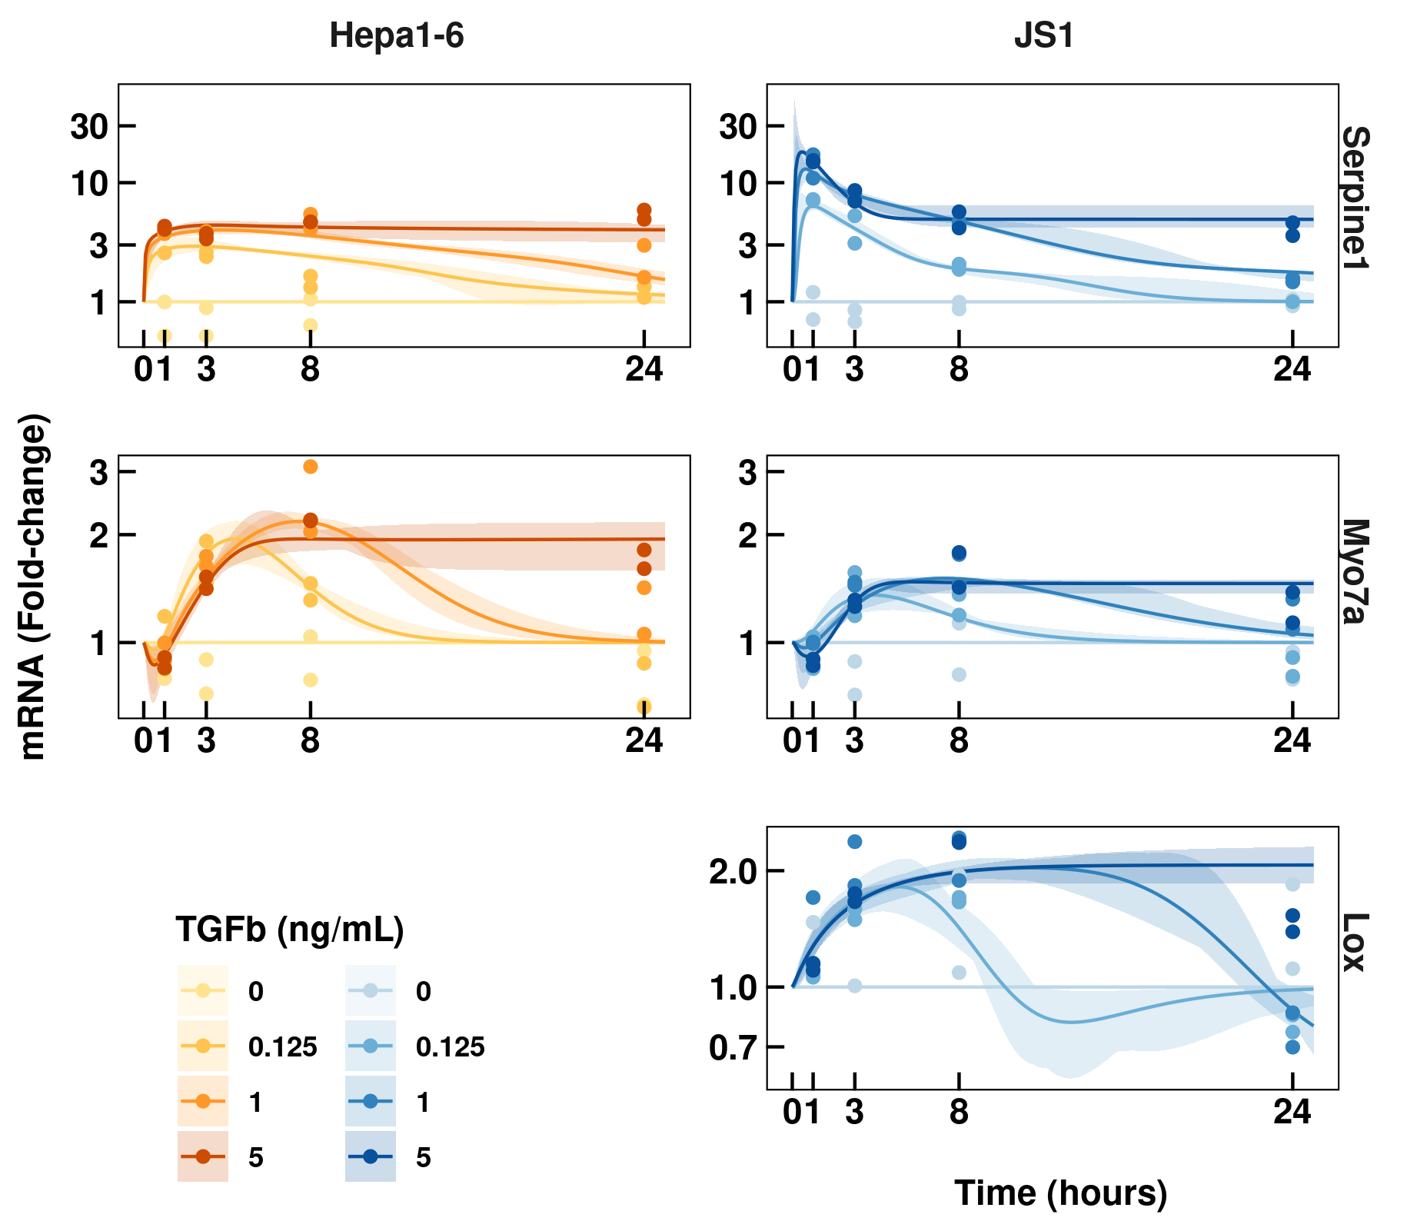
Differences in responses to TGFb stimulation
Common
Higher concentrations of TGFb extend the longevity of mRNA response
Saturation of the response already at 1 ng/ml
Different
Serpine1 peak induction is much higher in HSC
Lox is completely induced at the lower concentrations in HSC
Lox mRNA not detectable in Hepa1-6

Slide 19
Conclusions and outlook
Key points
Elucidated direct and indirect targets of TGFb in HSC
Adapted dynamic model of TGFb signal transduction to HSC
Potential therapeutic target: Lox
Outlook
Translation to PMHSC, PHHSC
Incorporate ECM related target proteins into dynamic model
Simulations of chronic stimulation

Slide 20
Acknowledgments
Division systems biology of signal transduction (DKFZ)
Ursula Klingmüller
Marcel Schilling
Lorenza D’Alessandro
Artyom Vlasov
Sandra Bonefas
Lena Postawa
Barbara Helm
Yannik Dieter
Molecular Hepatology (Uni Klinikum Mannheim)
Steven Dooley
Seddik Hammad
Anne Dropman
Kerry Gould
Data Analysis and Modeling of Dynamic Processes in the Life Sciences (Uni Freiburg)
Jens Timmer
Clemens Kreutz
Svenja Kemmer

