Slide 1
MIBBI - Minimum Information for Biological and Biomedical Investigations
26th – 28th November 2018
St. Bonifatiuskloster Hünfeld; Klosterstraße 5; D-36088 Hünfeld

Slide 2
What is MIBBI
Made by the Digital Curation Centre (DCC) (UK)
Solve extensive challenges of digital preservation & curation
Building capability and skills for research data management
DCC provides expert advice & practical help to researchers wanting to store, manage, protect and share digital research data
http://www.dcc.ac.uk/
Notes:
The Digital Curation Centre (DCC) was established to help solve the extensive challenges of digital preservation and digital curationand to lead research, development, advice, and support services for higher education institutions in the United Kingdom.^{[1]}

Slide 3
What is MIBBI
40 checklists of Minimum Information for various biological disciplines
Metadata Standards
Minimum Information Specification For In Situ Hybridization and Immunohistochemistry Experiments (MISFISHIE)
Minimum Information about a Genotyping Experiment (MIGen)
Minimum Information about a Flow Cytometry Experiment (MIFlowCyt)
Minimum Information About a Proteomics Experiment (MIAPE)
Minimum information about a microarray experiment (MIAME)
Minimum Information About an RNAi Experiment (MIARE)
Notes:
The Digital Curation Centre (DCC) was established to help solve the extensive challenges of digital preservation and digital curationand to lead research, development, advice, and support services for higher education institutions in the United Kingdom.^{[1]}

Slide 4
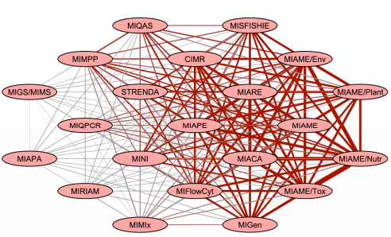
The MIBBI Network
https://fairsharing.org/collection/MIBBI
Notes:
The Digital Curation Centre (DCC) was established to help solve the extensive challenges of digital preservation and digital curationand to lead research, development, advice, and support services for higher education institutions in the United Kingdom.^{[1]}

Slide 5
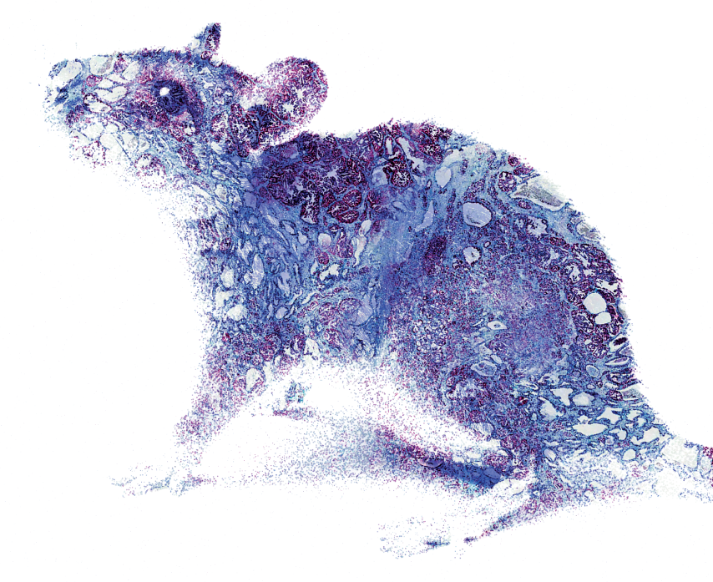
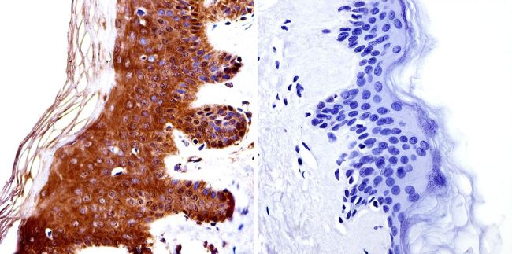
MISFISHIE
Guidelines for reporting relevant materials, methods and results of a gene/protein expression localization experiment
In Situ Hybridization
Immunohistochemistry
Source: https://acdbio.com/ ; https://www.thermofisher.com

Slide 6
MISFISHIE
Guidelines for reporting relevant materials, methods and results of a gene/protein expression localization experiment
Necessary to allow a researcher from a different lab to validate your findings
Experi-mental design
Staining
Imaging data
Image character-isation
Biomater-ials & Treatment
Reporter & Antibodys

Slide 7
MISFISHIE
IHC, ISH, tissue-specific
reporter expression
Experi-mental design
Assay type & numbers
Design type
Experimental factors
Description
Experimentator
comparison of normal vs.
diseased tissue
probe, antibody, disease state,
genetic variation, structural unit, age

Slide 8
MISFISHIE
strain, mutant alleles sex, age, developmental stage, genotype,
phenotype, disease, treatment, diet, provider
Biomaterial
&Treatment
Origin of the biological specimens
Manner of preparation of the specimens for the study
whole tissue, tissue sections, thickness, whole cells, or sections of cells, type of fixative & duration of fixation, sections mounted on slides vs. sections floating in reagents, protocols used

Slide 9
MISFISHIE
Reporter
&
Antibodies
genomic identifi-cation of each reporter
sequence, clone number
protocol
additional attributes of the reporter
how the reporters were designed
and produced or the source

Slide 10
MISFISHIE
number of reporters in the hybridization or stain & specific details about the detection method how the reporters were designed and produced or the source
Staining
reporter
protocol
assay controls
protocol used to produce the hybridization or IHC, e.g. buffer, temperature, post-wash conditions, etc.
nature of both positive and negative tissue
and reporter controls

Slide 11
MISFISHIE
Sufficient resolution to allow independent characterization
Provided in a standard file format (e.g., JPEG, PNG, GIF, TIFF)
Named or tagged with the reporter and specimen that they represent
Imaging
data
download
detection method
fluorescent wavelength,
microscope settings

Slide 12
MISFISHIE
Image character-isation
definition of structural units
intensity scale
documen-tation
present, absent, or equivocal for evaluating IHC stains
Important: clear definition of the used scales (independent investigators understand & apply the same criteria)

Slide 13
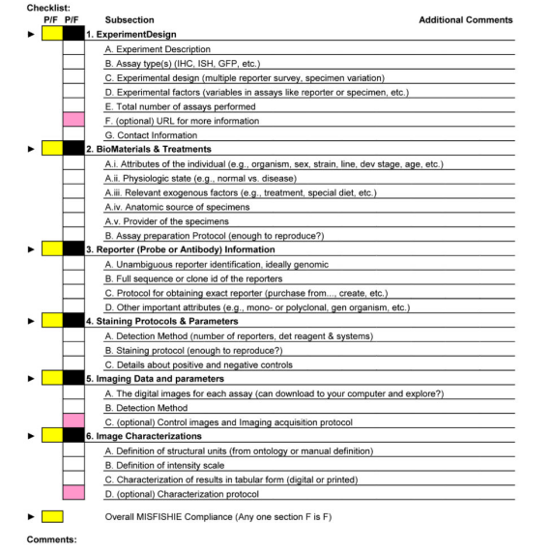
MISFISHIE -Checklist

Slide 14
MIAME
Guidelines describe information that needs to be provided to enable the interpretation of the results of a microarray-based experiment
most scientific journals have adopted MIAME guidelines as a requirement for publishing
Experi-mental design
Hybridizations
Measurements
Normalization controls
Array design
Samples

Slide 15
MIAME
Experimental design
contact informa-tion
design type
experi-mental variables
single/ multiple hybridi-sations
comparison of normal vs.
diseased tissue
time; dose; genetic variation; response to a treatment or compound

Slide 16
MIAME
array design name ; platform type; array provider; etc.
Array design
array related infor-mation
properties of each element type
specifi-cations
element type unique ID; single or double stranded; element (spot) dimensions
sequence accession number in DDBJ/EMBL/GenBank; sequence itself

Slide 17
MIAME
organism (NCBI taxonomy); age, sex, treatment genetic manipulation; etc.
Samples
sample source and treatment
Hybridisation extract prepara-tion
labeling
extraction method; RNA, mRNA, or DNA; amplification (RNA polymerases, PCR)
amount of nucleic acids labeled; label used (e.g., A-Cy3, G-Cy5, 33P, ….

Slide 18
MIAME
Hybridisations
solution
blocking agent
wash procedure
quantity of labelled target
time, concen-tration, volume, temper-ature
hybridi-sation instru-ments

Slide 19
MIAME
Normalisation controls
normalisation strategy
normalisation algorithm
control array elements
Spiking, houskeeping genes; etc.
linear /non-linear regression;
ratio statistics ; log(ratio) mean/median centering
position (the abstract coordinate on the array); control type (spiking, normalization, negative, positive)

Slide 20
Conclusion
Advantages
other researchers can compare and combine experiments with their own data, or test new methods
Data is available in a way that makes these data usable for others
data are accessible to everybody regardless of whether they are experts in the experiment analysis or not
build secondary databases, such as GENEVESTIGATOR, ONCOMINE, ArrayExpress Gene ExpressionAtlas
Disadvantages
Implementing MIBBI requirements has turned out to be challenging
standard computer-readable format is still missing

Slide 21
Other platforms & sources
Functional Genomics Experiment (FuGE)
object-oriented data model , capturing of (meta)data in a consistent manner
Reporting Structure for Biological Investigations (RSBI)
foundational lingua franca for standards projects
Ontology for Biomedical Investigations (OBI)
broad-scope ontology providing a self-compatible set of terms to describe biological and medical studies
Open Biomedical Ontologies (OBO)
coordinates the development of a set of ‘gold-standard reference ontologies’

Slide 22
Thank you for your attention

