Slide 1
A mechanical collagen model to study the formation of liver fibrosis
Jieling Zhao^{1,2} and Dirk Drasdo^{1,2}
in collaboration with
Ahmed Ghallab¹, Ayham Zaza¹, Jan G. Hengstler¹
Seddik Hammad³, Steven Dooley³
Andreas Buttenschoen⁴
¹IfADo, Dortmund, Germany, ²INRIA, Paris, France, ³UMM, Mannheim, Germany, ⁴UBC, Vancouver, Canada

Slide 2
Introduction
Liver fibrosis is a characteristic of most types of chronic liver disease
Results from chronic damage
Excessive accumulation of ECM proteins (collagen)
Results in cirrhosis and eventually liver failure
Figure from A Ghallab

Slide 3
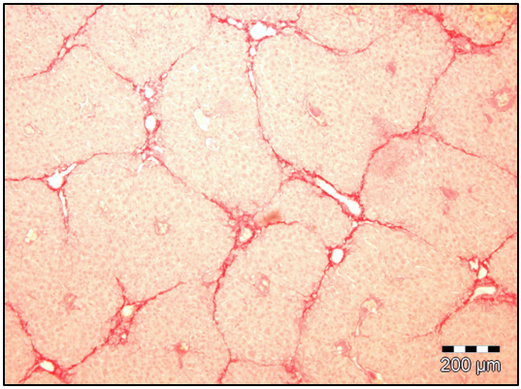
Motivation
The mechanism behind the formation of fibrosis pattern is still not well understood
How the "bridging pattern" is formed during chronical injury?
Computational modeling aspects of fibrosis process may provide insights towards novel treatment strategies
Iteration of computational model and experiments for refinement and improvement
Figure from A Ghallab: fibrotic liver due to chronic injury (red: staining of collagen)

Slide 4
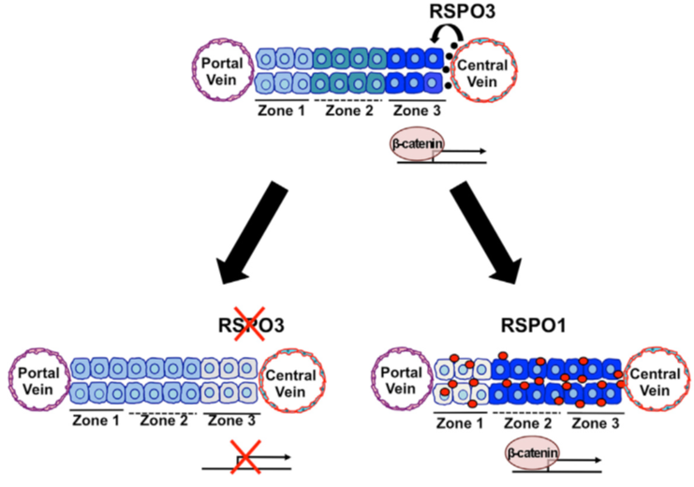
From biology to mathematical model
Fibrosis pattern: perhaps due to
Chemical signals
Mechanical forces
Activator-inhibitor system
Protein signal activating collagen expression (activator)
Protein signal inhibiting collagen expression (inhibitor)
Physical contact between cells and collagen fibers
One possible activator: Rspondin3, Rocha, et al, Cell Rep. 2015

Slide 5
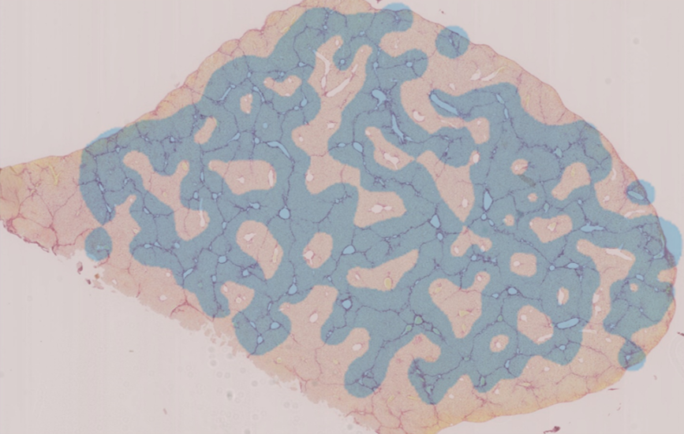
Activator-inhibitor system
Activator-inhibitor regulating CYP pattern
Activator released from the Central Vein (CV)
Inhibitor released from the Portal Vein (PV)
Our modeled CYP region generally covers the regions where collagen is generated and concentrated
But not specific for the collagens
Our modeled CYP pattern (cyan) covers almost all of the collagens (pink) with high sensitivity ~ 93%, but low specificity ~ 30%
Collagen staining is from A Ghallab

Slide 6
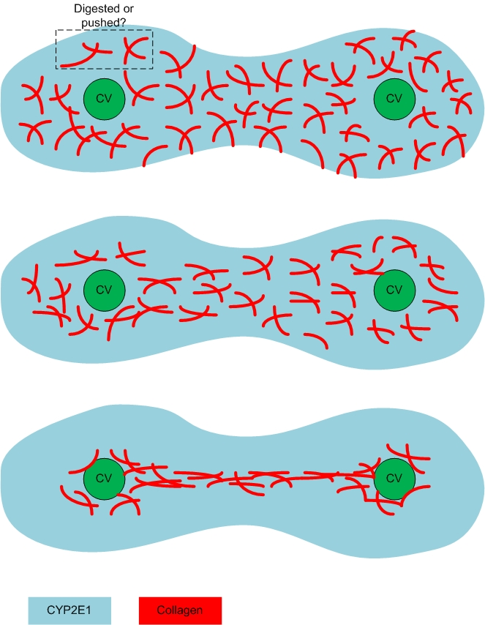
The possible mechanism incorporating collagen-cell mechanics
Collagens are overexpressed in the CYP region
During the liver regeneration, proliferating cells push and suppress the collagen network
After regeneration is completed, the "bridging pattern" of collagen fibers is formed

Slide 7
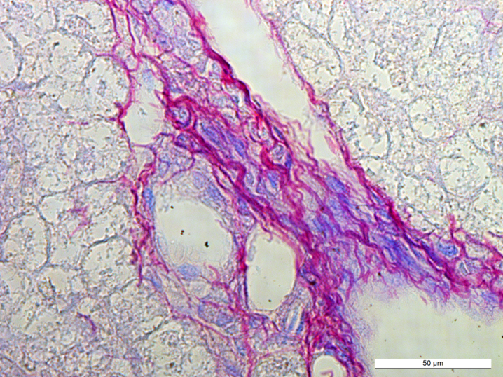
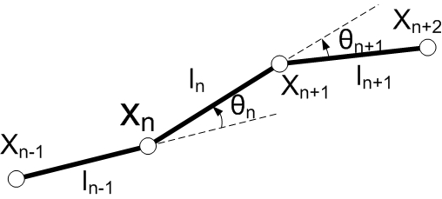
Collagen model
We model collagen as meshwork
Mechanical property of collagen fibers
Linear springs
Rotational springs
Collagen type I (purple) in mouse upon chronic injury, data is from S Hammad
Collagen fibers are modeled as linear / rotational springs

Slide 8
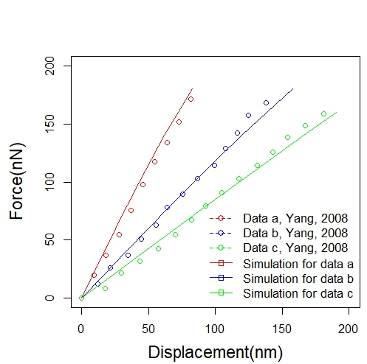
Validating the model: Bending
Collagen bending test
One single fiber is fixed on the device. Forces are applied on different positions of it
The experimental study we compared to: Yang, et al, Biomaterials, 2008
Our model can well capture the bending behavior of the collagen fiber
Left: diagram of bending test for single fiber, forces are exerted on different position; Right: our modeled deformation of the fiber due to exerted force
Our modeled fiber force-displacement curve fits the experimental data (Yang, et al, 2008) perfectly

Slide 9
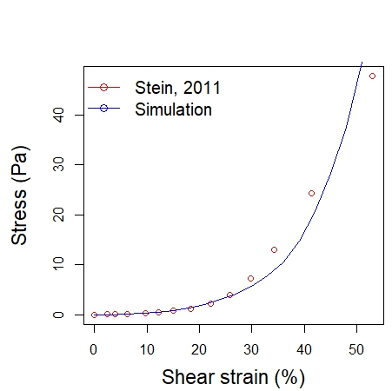
Validating the model: Shear
Collagen shear test:
Collagen network is sheared
The experimental study we compared to: Stein, et al, Complexity, 2011
Our model can well capture the network shear mechanics up to 45% of the shear deformation
Left: collagen network at relaxed status; Right: shear is applied
Our modeled network strain-stress curve well fits the experimental data (Stein, et al, 2011) up to 45% of shear

Slide 10
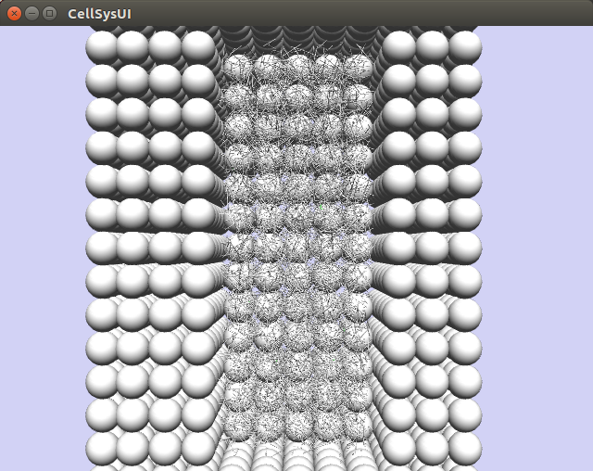
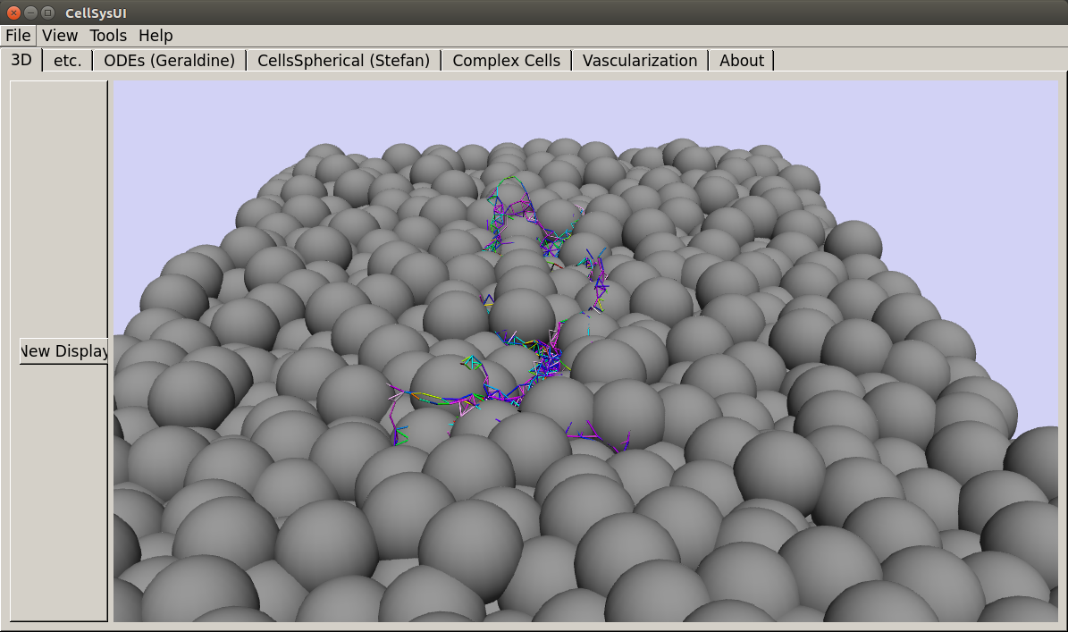
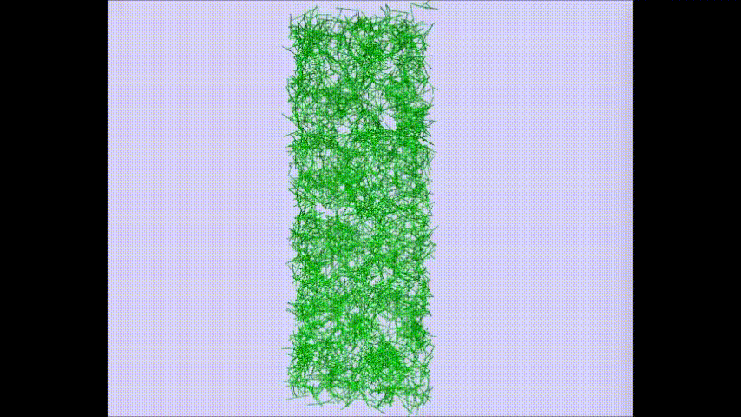
A toy model of fibrosis
Cross-section of the toy lobule after the toy lobule is regenerated, the collagen meshwork is compressed into "bridging" pattern
A simple model to test our proposed mechanism
A toy lobule: the interior void represents the CYP region filled by overexpressed collagen fibers

Slide 11
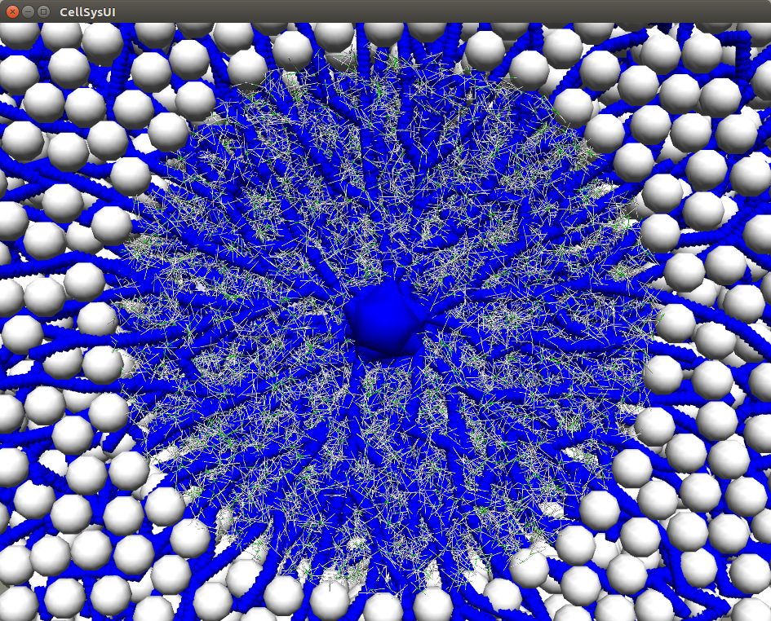
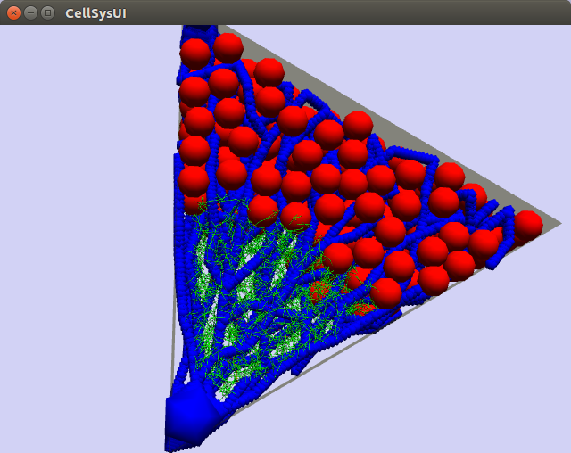
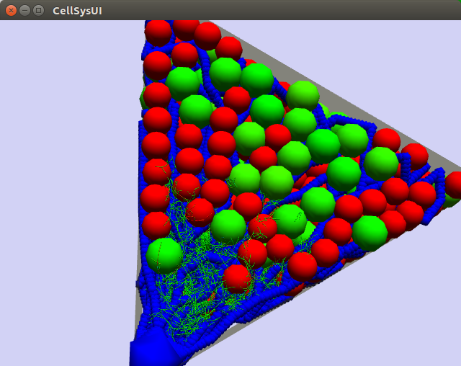
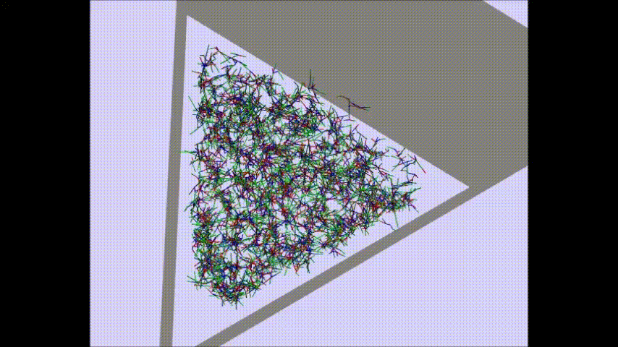
Incorporate the collagen model into lobule
Embed collagens into the lobule
Collagen density: 0.5 mg / mL
Prelim result: first show the simulation in 1/6 of the lobule

Slide 12
Summary
Our collagen model can capture the fundamental mechanical properties of the collagen fiber/network
Bending
Shear
The proposed mechanism of formation of "bridging pattern" can be reproduced using a toy collagen model
The collagen model is incorporated into the lobule model

Slide 13
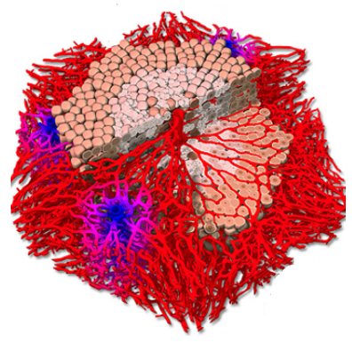
Future plan
More cell types added into the model
Stellate cells
Producing collagens
Macrophages
Digest collagens
Endothelial cells
Sources of many chemical signals (e.g. Rspondin3)
Apply collagen models into multi-lobules
Combine the two components together
Activator-inhibitor system
Cell-collagen mechanics

Slide 14
Acknowledgement
IfADo
Jan G. Hengstler
Ahmed Ghallab
Ayham Zaza
Tim Johann
INRIA
Dirk Drasdo
Paul Van Liedekerke
Yi Yin
UMM
Steven Dooley
Seddik Hammad
UBC
Andreas Buttenschoen
UL
Stefan Hoehme
Funding

Slide 15
Appendix: parameters
Collagen
Radius: 100 nm
Young's modulus: 50 MPa
Fiber length: 6 μm
Cell (Hepatocyte)
Radius: 23.3 μm
Young's modulus: 450 Pa
Cycle time: 24 hours
Vessel
Radius: 4 μm
Young's modulus: 600 Pa
Lobule
Radius: 300 μm

